Slide 1
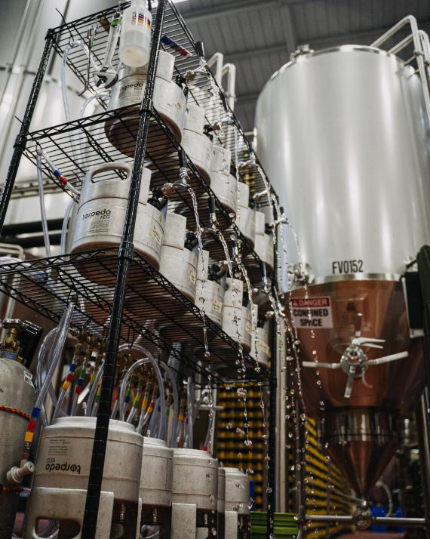
You Can’t Always Get What You Want - Use of Design of Experiments (DOE) to Optimize Dry Hop Mixtures for Aroma and Flavor
Becca Ransohoff, Trent Leslie,
Douglas Scott, Chandler Cottrell
MadTree Brewing
Cincinnati, OH

Slide 2
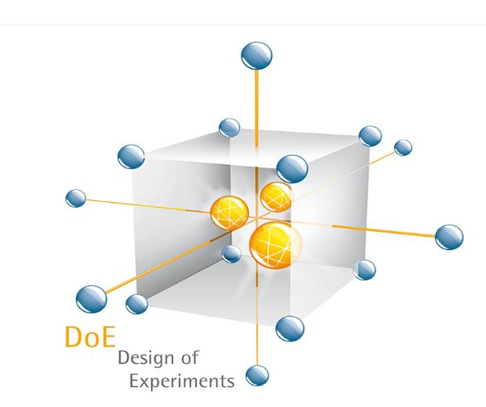
Design of Experiments
Understanding complex systems (such as beer) by intentionally designing and executing experiments that help us investigate how variables in a system interact
Design experiments with terms that help you develop mathematical models to better understand relationships between variables

Slide 3
One-Variable-at-a-Time Approach
Only look at a slice of an area of flavor space
Can’t see interaction effects
Minimum of two weeks in between tasting any test batches
can’t compare changes in recipe or process between finished products
Inefficient – Can’t necessarily attribute changes in response to specific process or variable changes
DOE Approach
Learn about a selected “region” of the flavor space
See how all factors interact at once in the same base beer
Help minimize effects from natural variation in fermentation
Efficient – model all interactions at once, confirmation of model predicted optimum can be used for additional testing

Slide 4
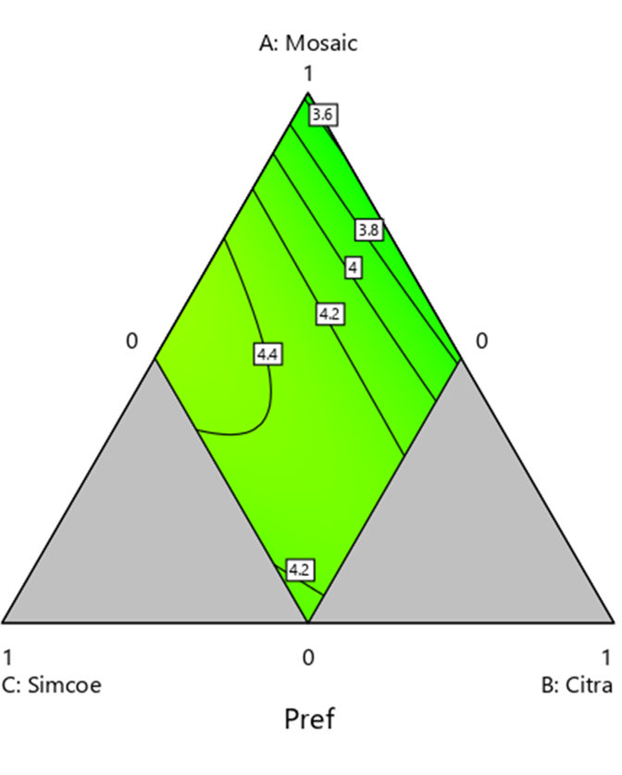
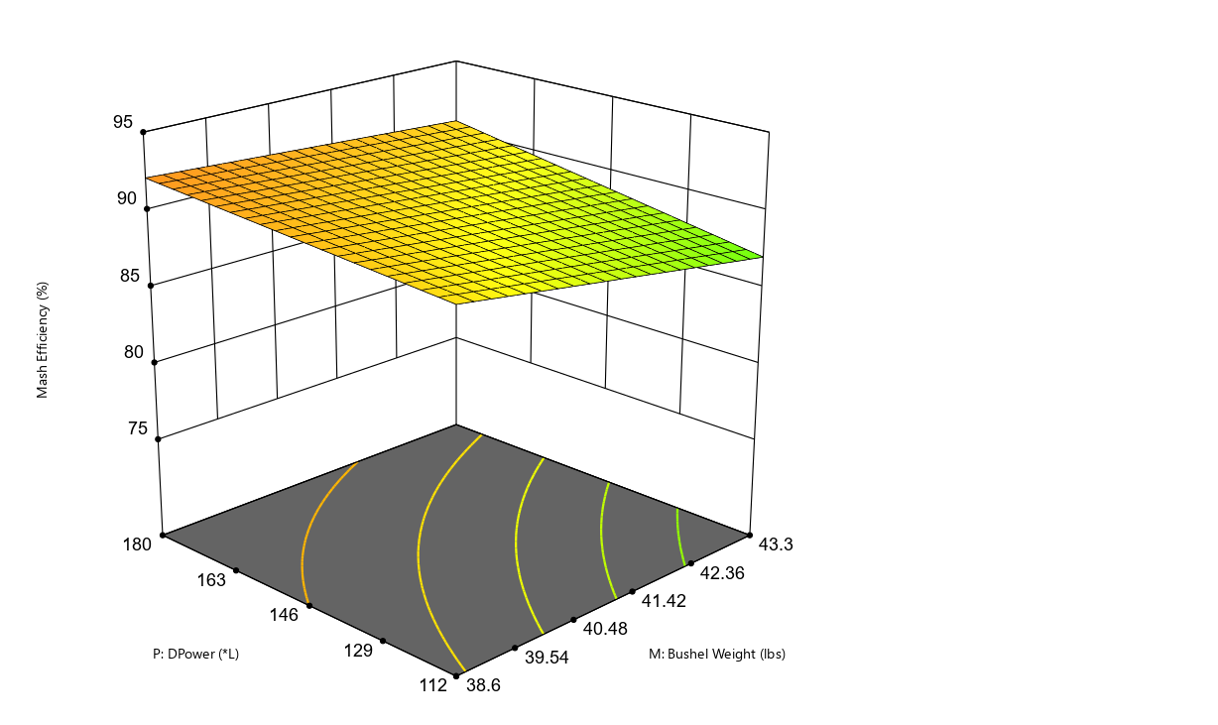
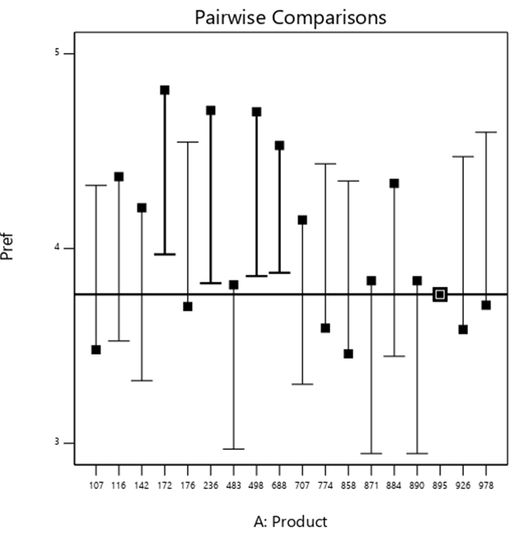
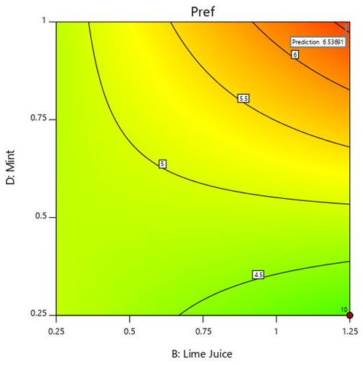
What Type of Experiment to Pick?
All depends on the type of data you are collecting and the questions you are asking
Simple comparison, factorial design, mixture experiment, response surface

Slide 5
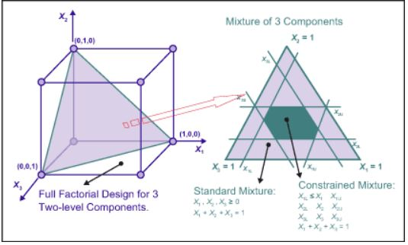
Mixture Experiments
2-dimensional slice of a 3-dimensional factorial space
Factors are interdependent – the sum of all factors = 1
Image taken from SixSigma

Slide 6
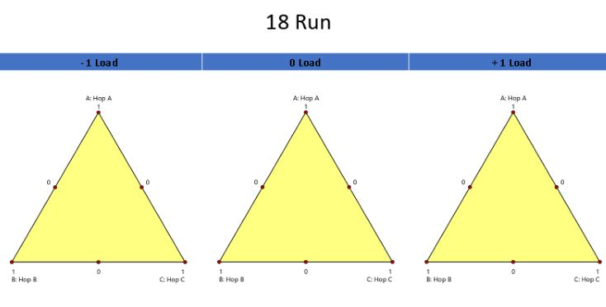
18 Runs – Full Model
Run | A:Hop A | B:Hop B | C:Hop C | D:Hop Load
1 | 0.5 | 0 | 0.5 | -1
2 | 0.5 | 0.5 | 0 | 1
3 | 0 | 1 | 0 | -1
4 | 0 | 0 | 1 | 0
5 | 0.5 | 0.5 | 0 | -1
6 | 0 | 1 | 0 | 1
7 | 0.5 | 0 | 0.5 | 0
8 | 0.5 | 0 | 0.5 | 1
9 | 0 | 0 | 1 | 1
10 | 0 | 0 | 1 | -1
11 | 1 | 0 | 0 | 1
12 | 0 | 0.5 | 0.5 | 1
13 | 0 | 0.5 | 0.5 | -1
14 | 1 | 0 | 0 | 0
15 | 0.5 | 0.5 | 0 | 0
16 | 0 | 0.5 | 0.5 | 0
17 | 1 | 0 | 0 | -1
18 | 0 | 1 | 0 | 0
Model Terms: A, B, C, AB, AC, AD, BC, BD, CD, ABD, ACD, BCD, AD^2, BD^2, CD^2, ABD^2, ACD^2, BCD^2

Slide 7
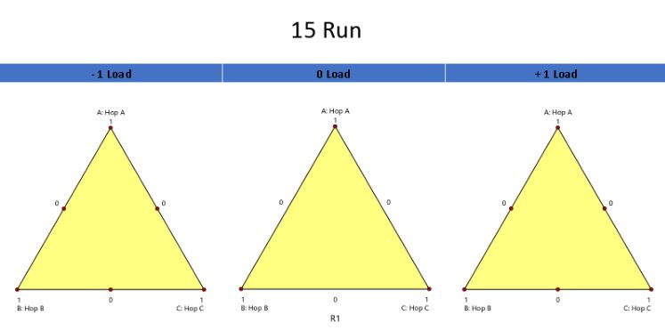
12 Runs
Run | A:Hop A | B:Hop B | C:Hop C | D:Hop Load
1 | 0.5 | 0.5 | 0 | 1
2 | 1 | 0 | 0 | 0
3 | 0 | 0.5 | 0.5 | -1
4 | 0.5 | 0 | 0.5 | -1
5 | 0.5 | 0.5 | 0 | -1
6 | 0 | 0 | 1 | 0
7 | 0.5 | 0 | 0.5 | 0
8 | 0 | 0.5 | 0.5 | 1
9 | 0 | 0.5 | 0.5 | 0
10 | 0.5 | 0.5 | 0 | 0
11 | 0.5 | 0 | 0.5 | 1
12 | 0 | 1 | 0 | 0
Model Terms: A, B, C, AB, AC, AD, BC, BD, CD, AD^2, BD^2, CD^2

Slide 8
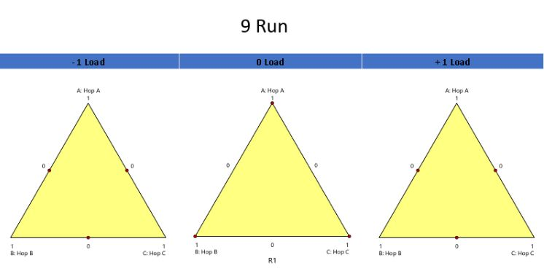
9 Runs
Run | A:Hop A | B:Hop B | C:Hop C | D:Hop Load
1 | 1 | 0 | 0 | 0
2 | 0 | 1 | 0 | 0
3 | 0.5 | 0.5 | 0 | -1
4 | 0.5 | 0 | 0.5 | 1
5 | 0.5 | 0.5 | 0 | 1
6 | 0 | 0.5 | 0.5 | 1
7 | 0.5 | 0 | 0.5 | -1
8 | 0 | 0.5 | 0.5 | -1
9 | 0 | 0 | 1 | 0
Model Terms: A, B, C, AB, AC, AD, BC, BD, CD

Slide 9
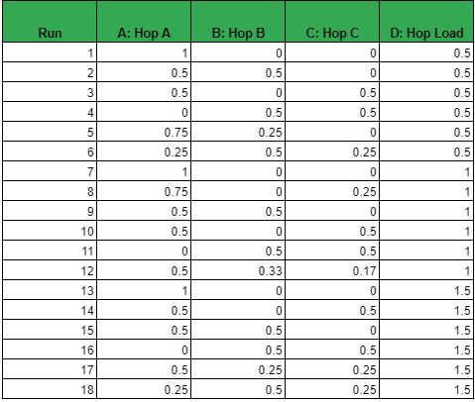
The Experiment
Goal – Finalize a dry-hop recipe for a new Double IPA recipe
Mixture experiment
Experimental Variables – 3 different hops
Hop A – 0-100%
Hop B and C – 0-50%
Experimental Ranges – Range of 0-1.5x dry hop rate (1.9 lbs/bbl)
Things we did not study – any hot side changes, limited to 3 hops, yeast strains
Important to understand – factors, ranges, responses, how and when to collect samples

Slide 10
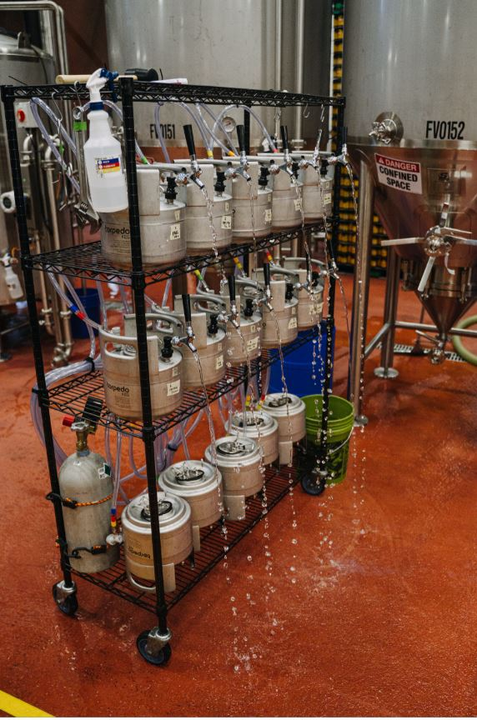
The Set Up
The following costs are associated with a 10-vessel collection system
Rack with Casters – $200
Stainless 1.5-gallon Kegs – $80 x 10 - $800
CO2 Manifold and Tubing – $200
Various fittings – $400
CO2 Tank – $50
Temperature Controlled Storage (chest freezer) - $800
Scale – $500
Total ~$3,000
This is an investment, but trust us – it is much nicer than collecting into growlers!

Slide 11
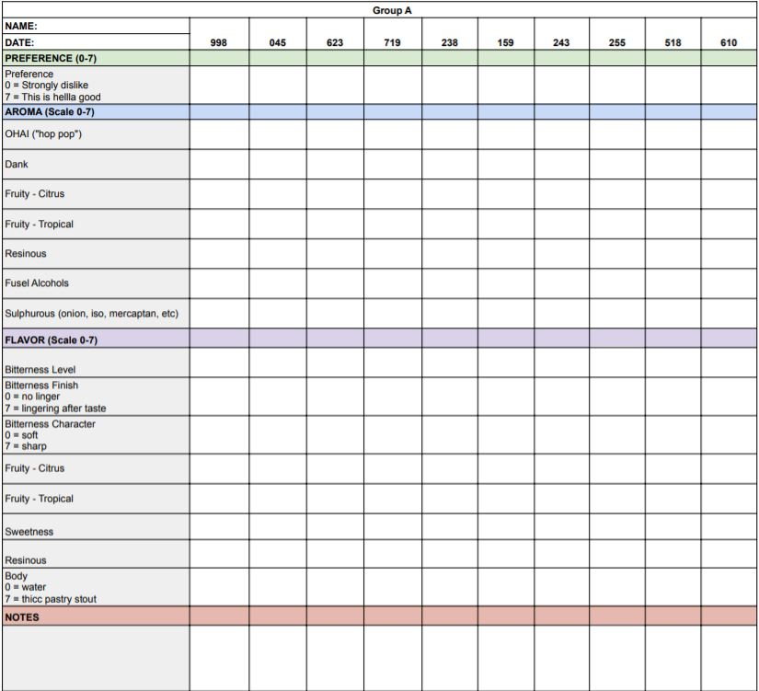

Sensory Collection
15 panelists – from trained research panel
Incomplete block – 2 groups each receiving 10 samples in one sitting
Scaling 7 aroma attributes, 8 taste attributes and overall preference
Collected over a one-week span

Slide 12
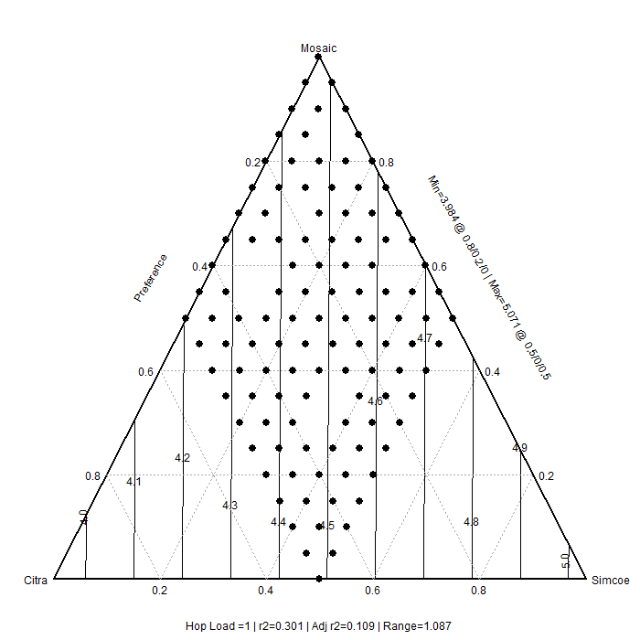
Analysis
Full analysis in R – a free software environment
Blocking of panelists
Development of contour plots
Optimization
In depth into the development of the script and its application can be seen in But Sometimes You Get What You Need: Using R to Optimize Dry Hop Mixtures for Aroma and Flavor

Slide 13
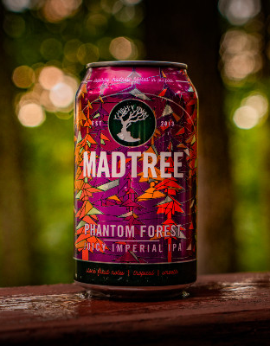
Optimization and Finalization
Data provides the tool to help Production, Marketing and Sales
Collecting the data and developing the model is just the first step – Need to prioritize important aspects of the desired outcome
Priorities for this experiment
High preference scores
Inclusion of Hop A
Cost

Slide 14
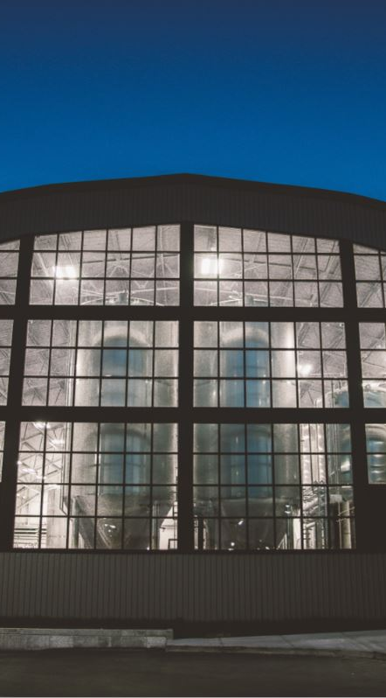


Flavor Space Force Research Group
Trent Leslie
Doug Scott
Chandler Cottrell
Ryan Blevins
Garrett Schnieber

Slide 15
Notes:
SAY:
It’s time to answer some of the questions you’ve been asking from the Q&A panel.
DO:
Make sure to use their name and show appreciation for the comment.

